Slide 1
Final Project INFO-5100 Making a difference
By:
Vidhi Patel (002641341)
Vaibhavee Gamit (002821886)
Rama Chandra Kashyap Mamidipalli(002812095)

Slide 2
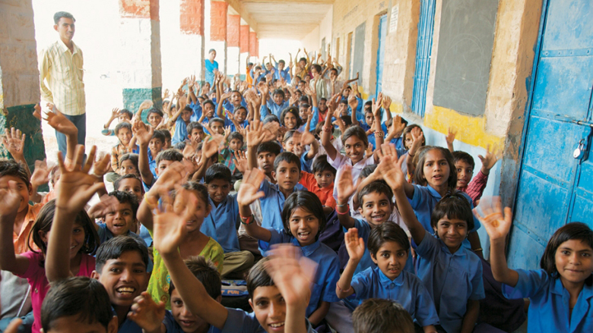
Problem Statement
Today, some of the major problems faced by developing countries are illiteracy, poor health, and lack of necessities among underprivileged people. Our vision is to increase literacy among the people, improve their health, and provide them with the required things that ultimately improves their life.

Slide 3
Solution
NGOs are trying their best to help the people and we aim to make their work easier by building and providing an application that acts as a bridge and connects various NGOs, Hospitals, Government, and Logistics in the loop with people who want to donate, or volunteer for NGO work.

Slide 4

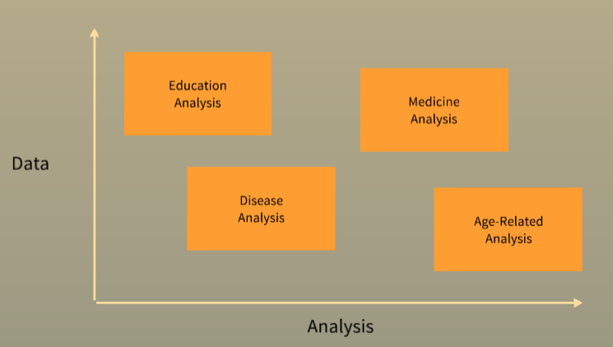
Approach
Connect the volunteers to NGOs who are willing to help the needy by providing them with good education and awareness programs.
Connect the Doctors to NGOs who might want to help in improving these people’s health.
Connect the pharmacies to these NGOs who can help them in providing the necessary medicines doe the needy people.
Connect the Volunteers to the NGOs who want to donate their things such as books, clothes, electronic devices, etc.
Connect a logistics system that does the work of transferring the things from one place to another.
Connect Government to all these entities so that it can use the data to find the underlying problems and issues inside the country and work on them.

Slide 5
Key Enterprise
Non-Government Organization (NGO)
Hospital
Government
Logistics

Slide 6
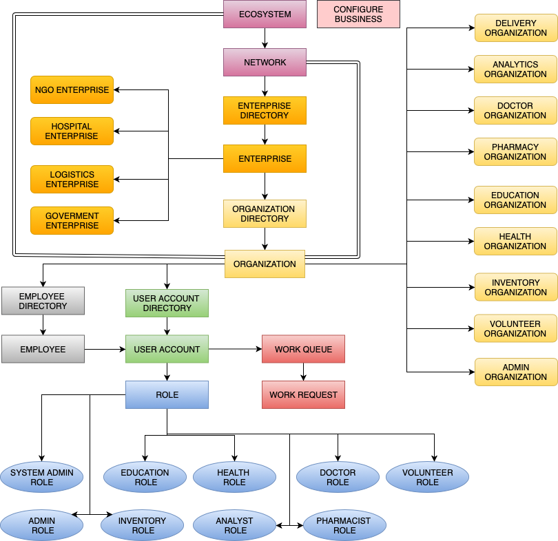
Object Model

Slide 7
Use Case 1
EDUCATION-VOLUNTEER WORK REQUEST

Slide 8
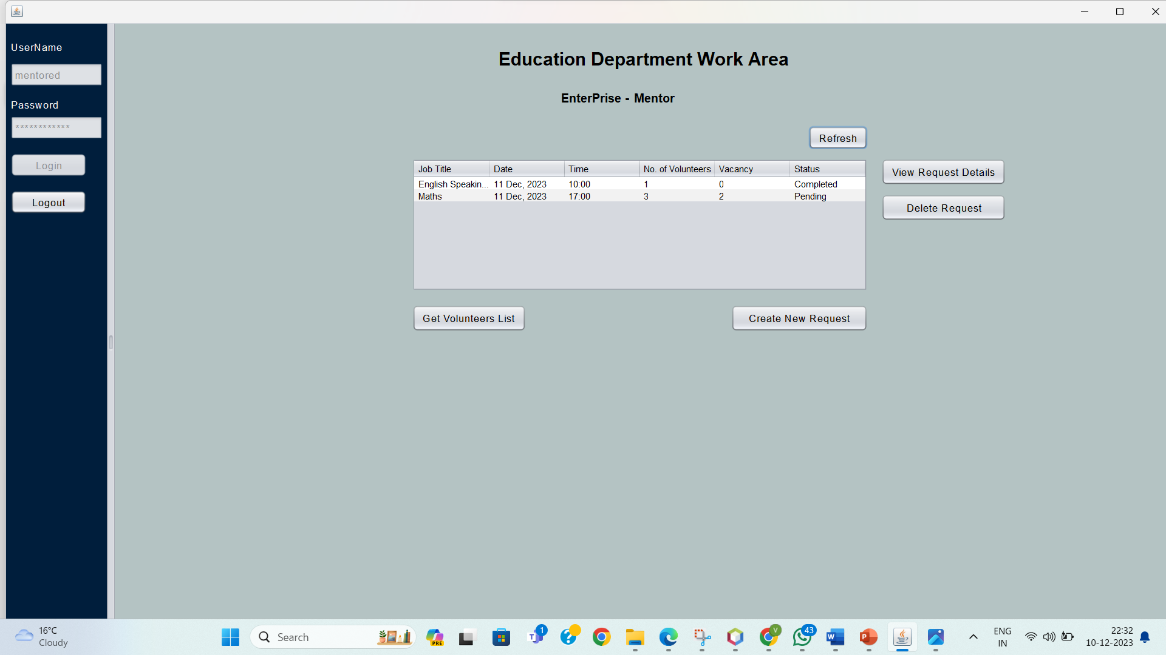

Slide 9
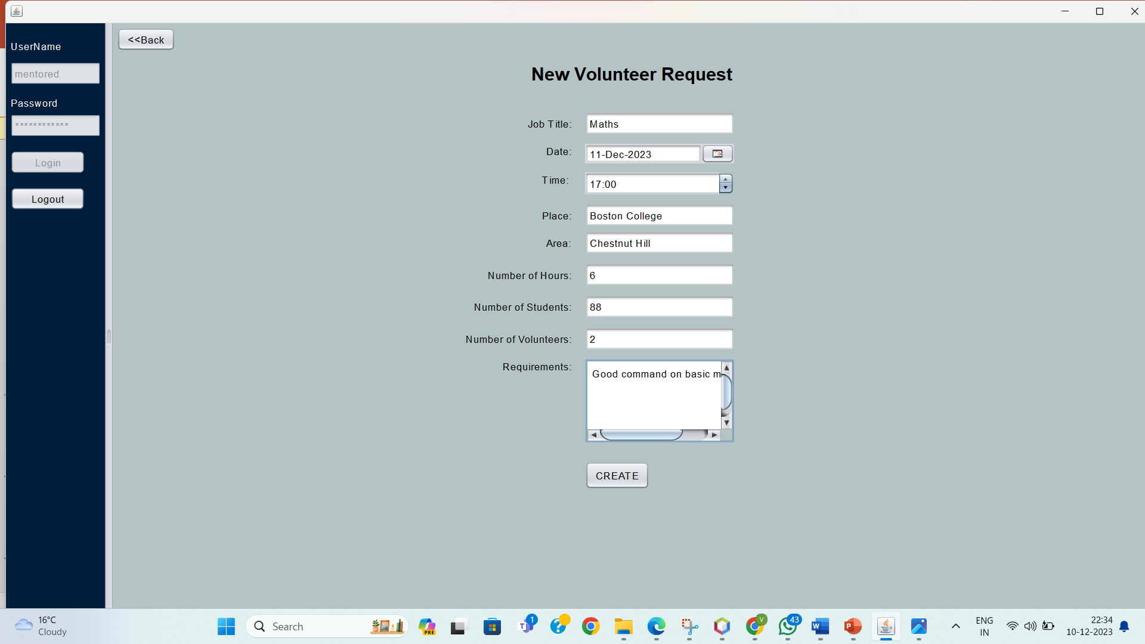

Slide 10
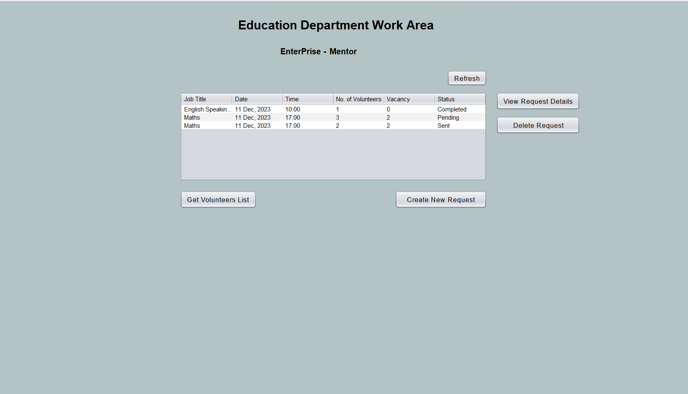

Slide 11
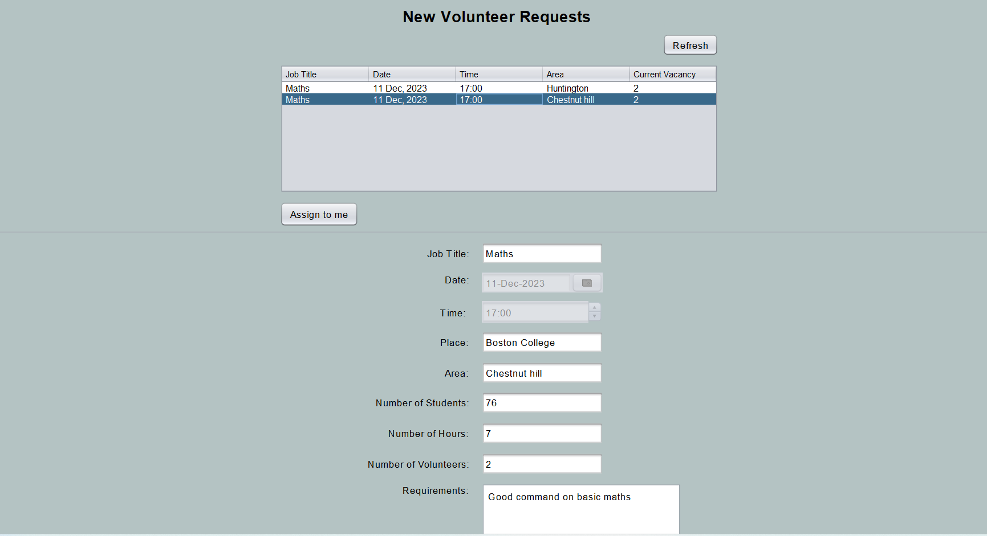

Slide 12
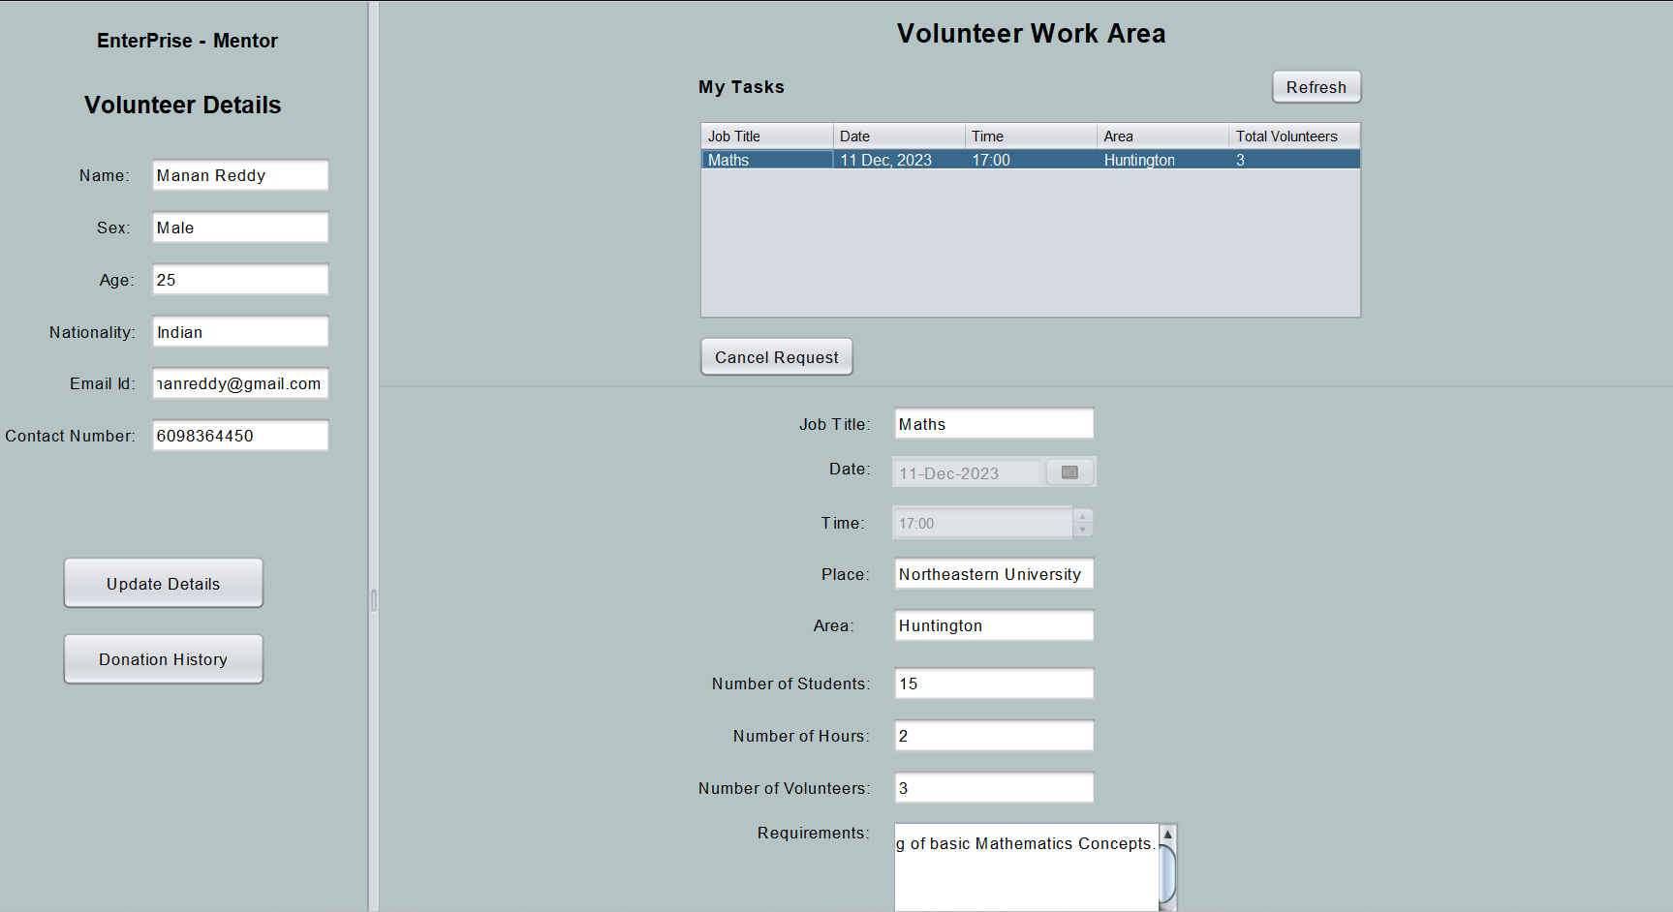

Slide 13


Slide 14
Use Case 2
VOLUNTEER-INVENTORY WORK REQUEST

Slide 15
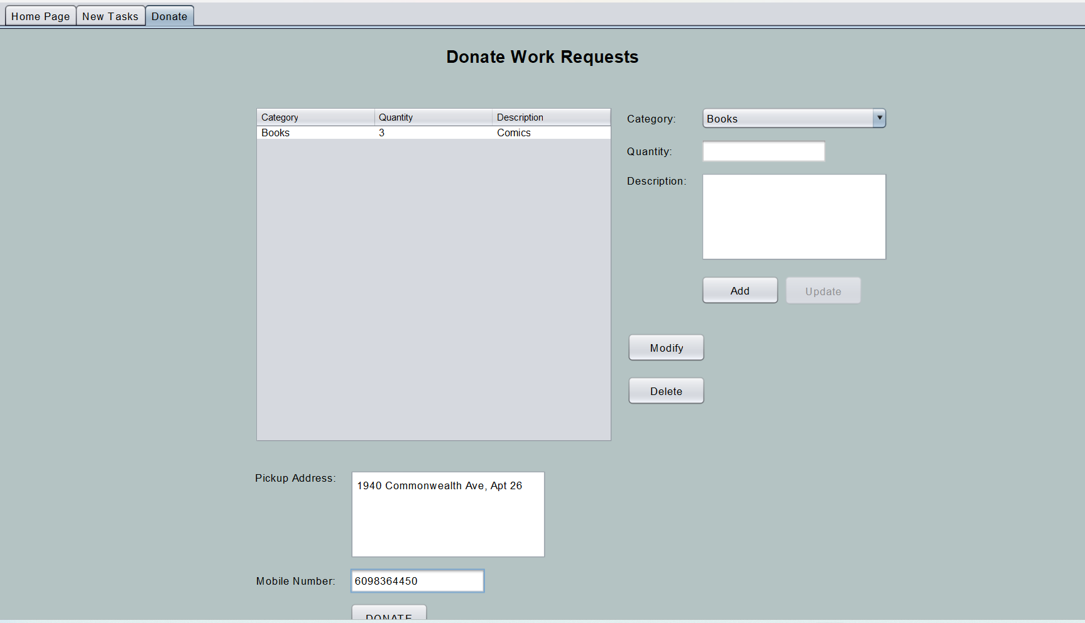

Slide 16
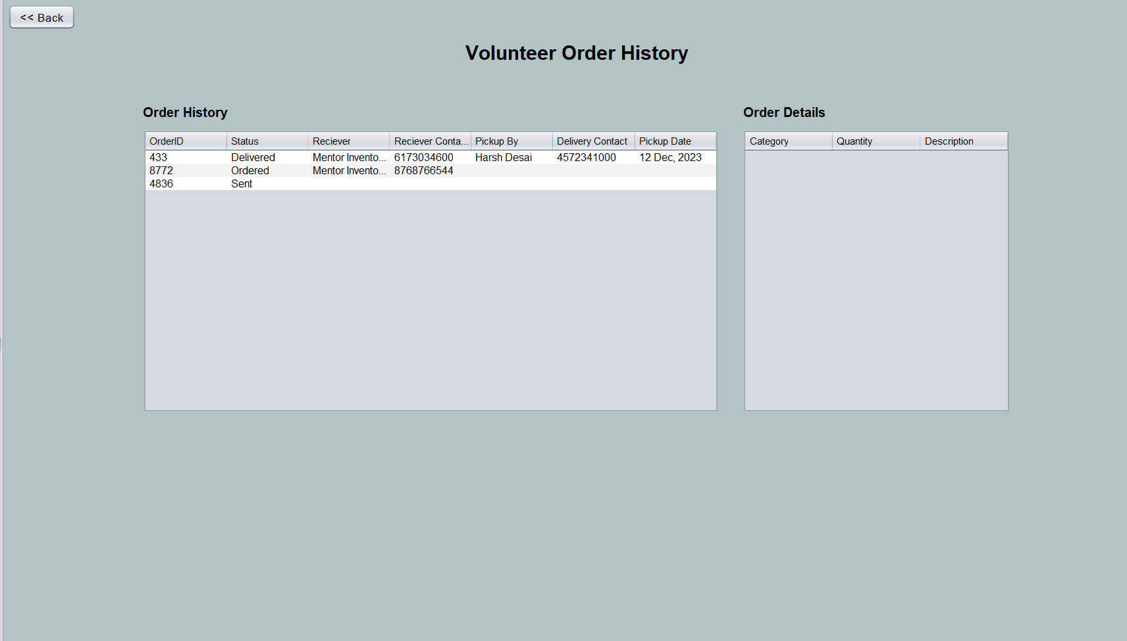

Slide 17
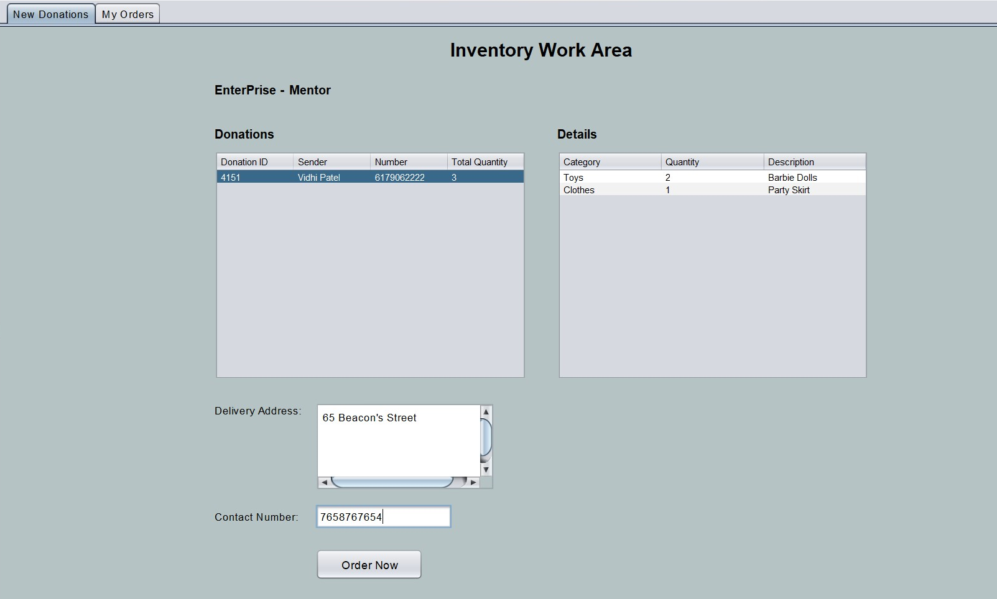

Slide 18
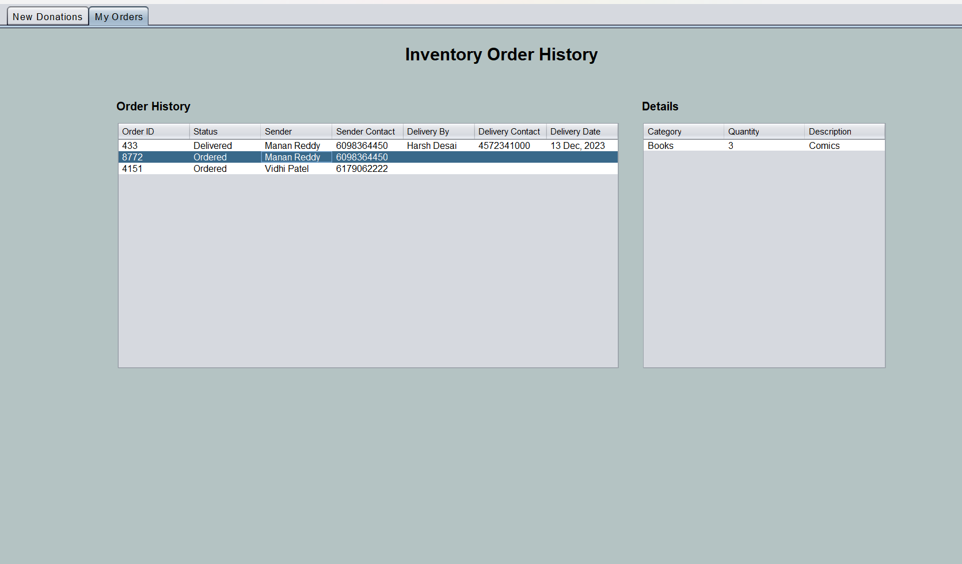

Slide 19
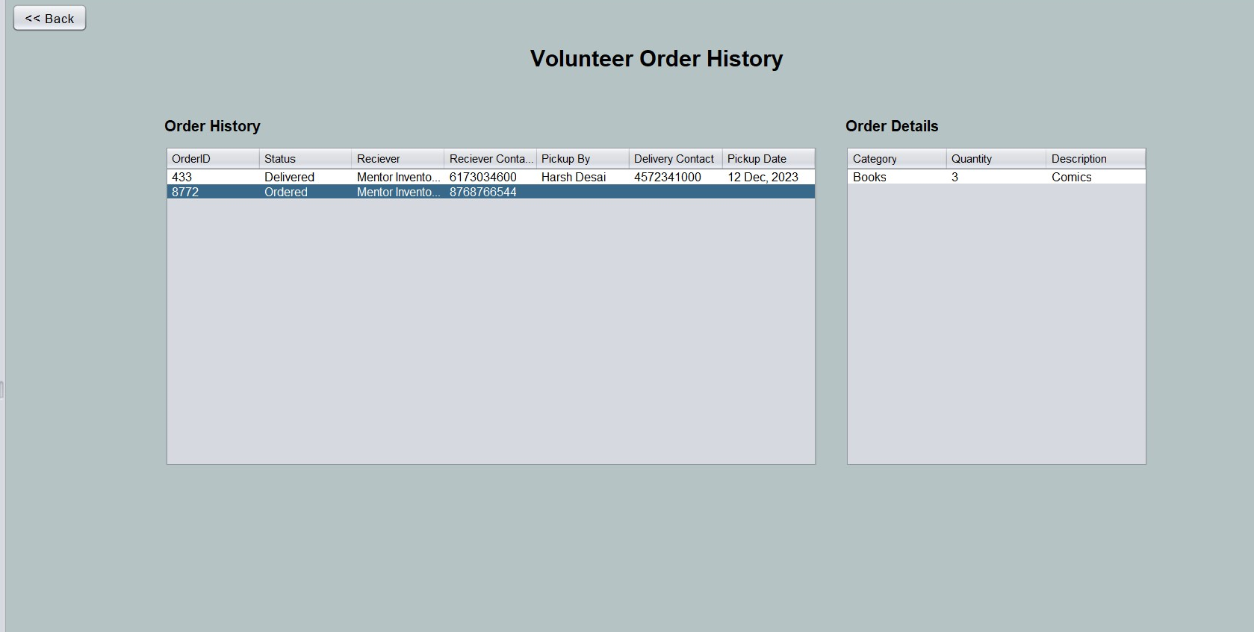

Slide 20
Use Case 3
HEALTH DEPARTMENT-DOCTOR WORK REQUEST

Slide 21
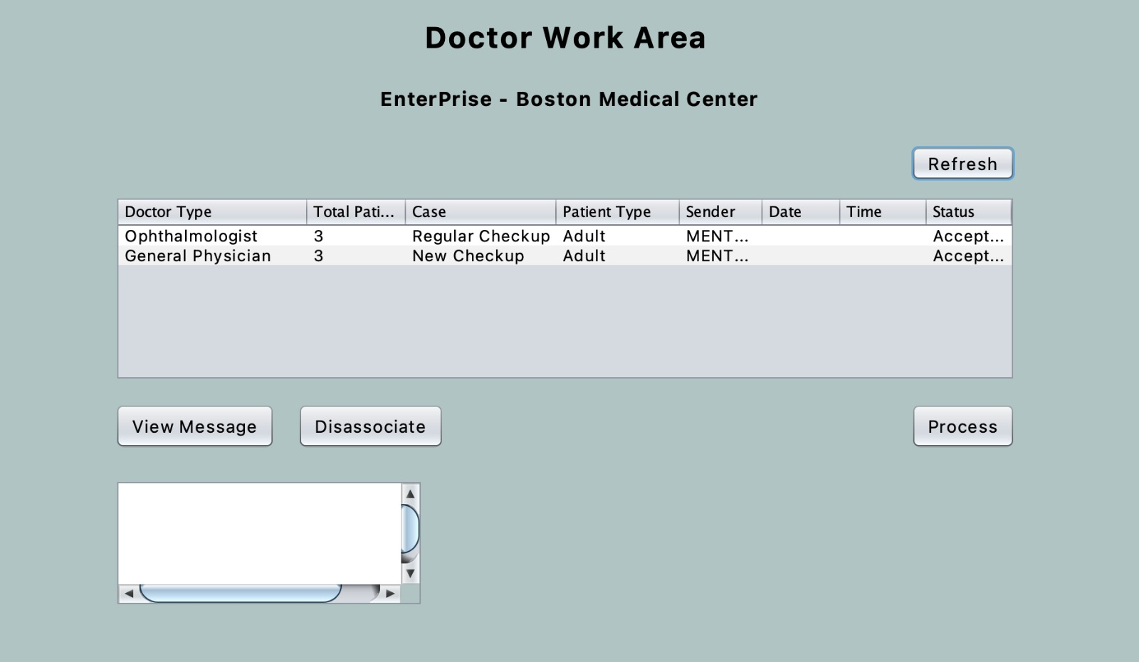

Slide 22
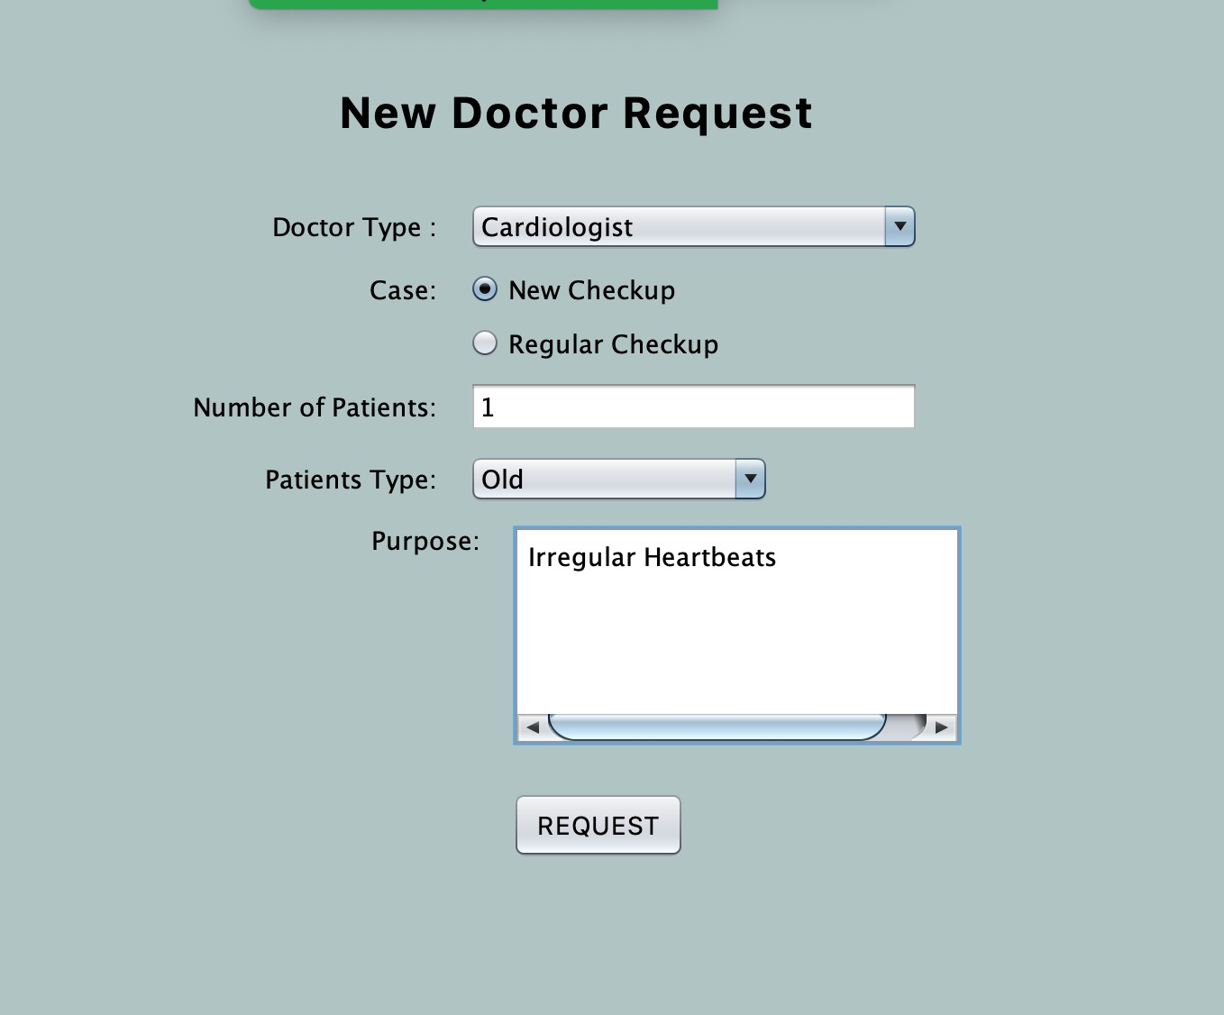

Slide 23
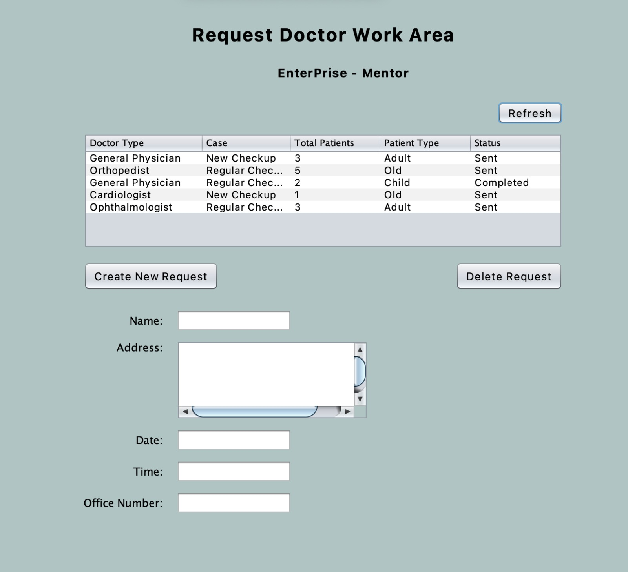

Slide 24
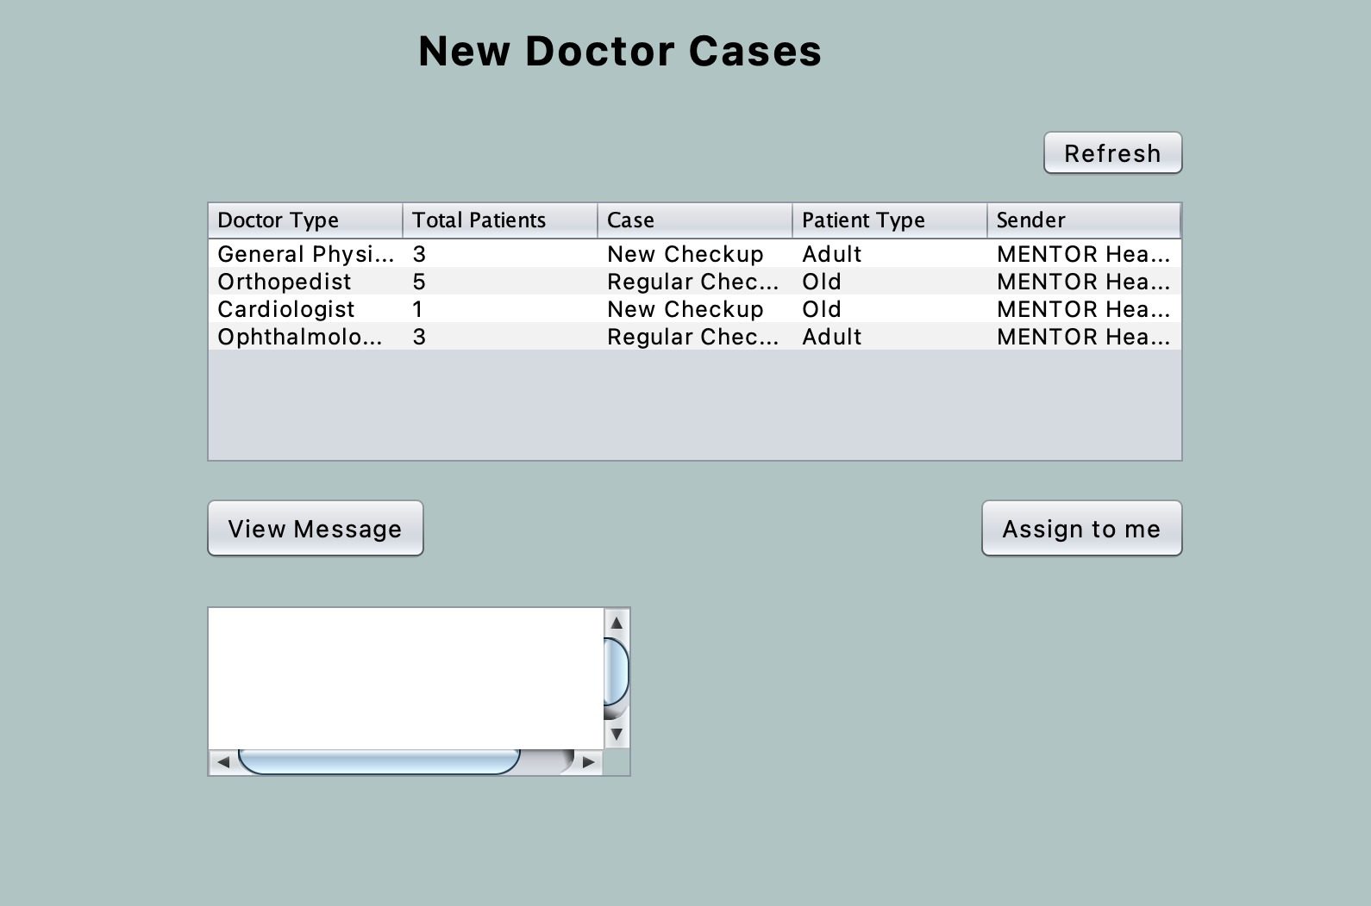

Slide 25
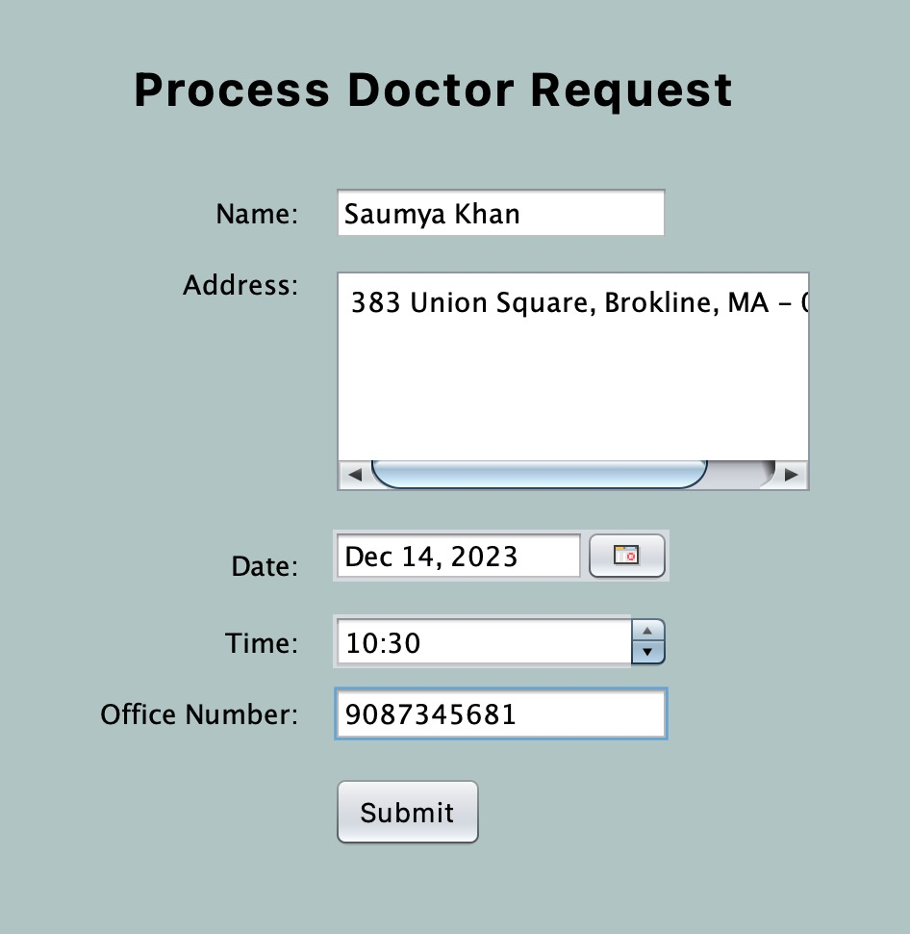

Slide 26
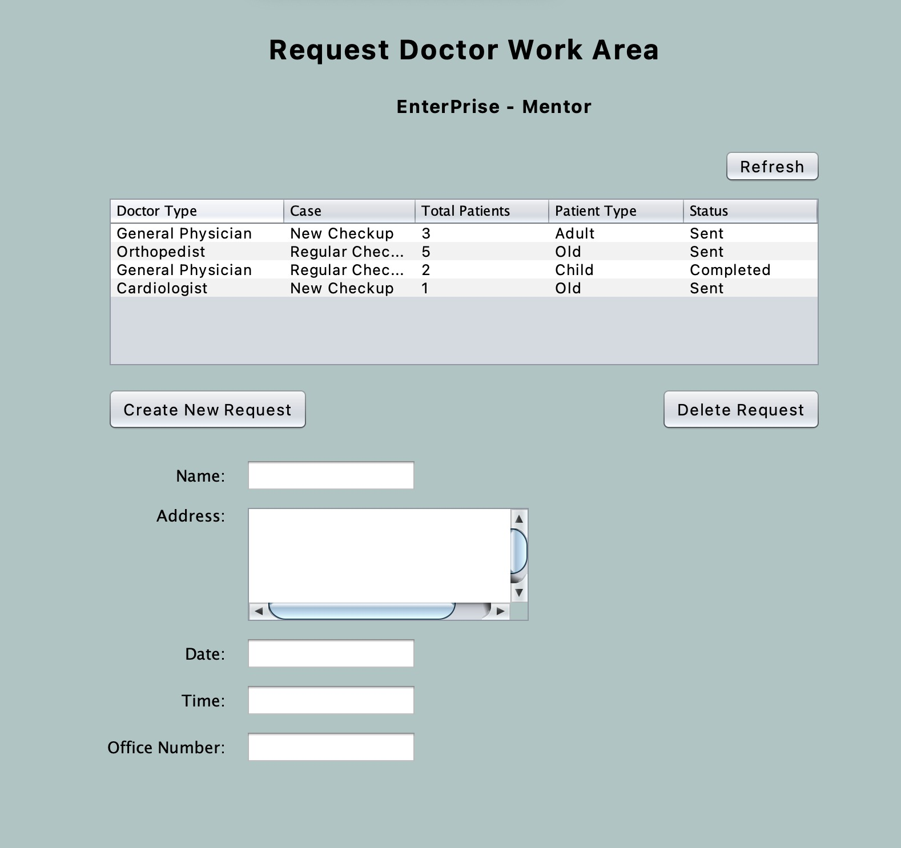

Slide 27
Use Case 4
HEALTH DEPARTMENT-PHARMACY WORK REQUEST

Slide 28
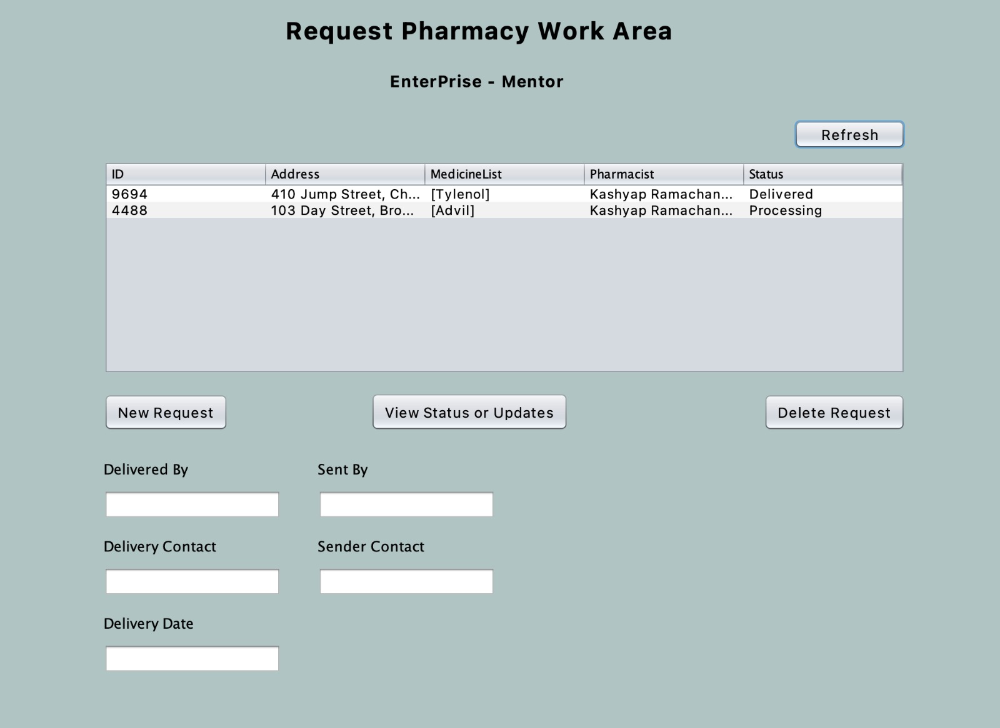

Slide 29
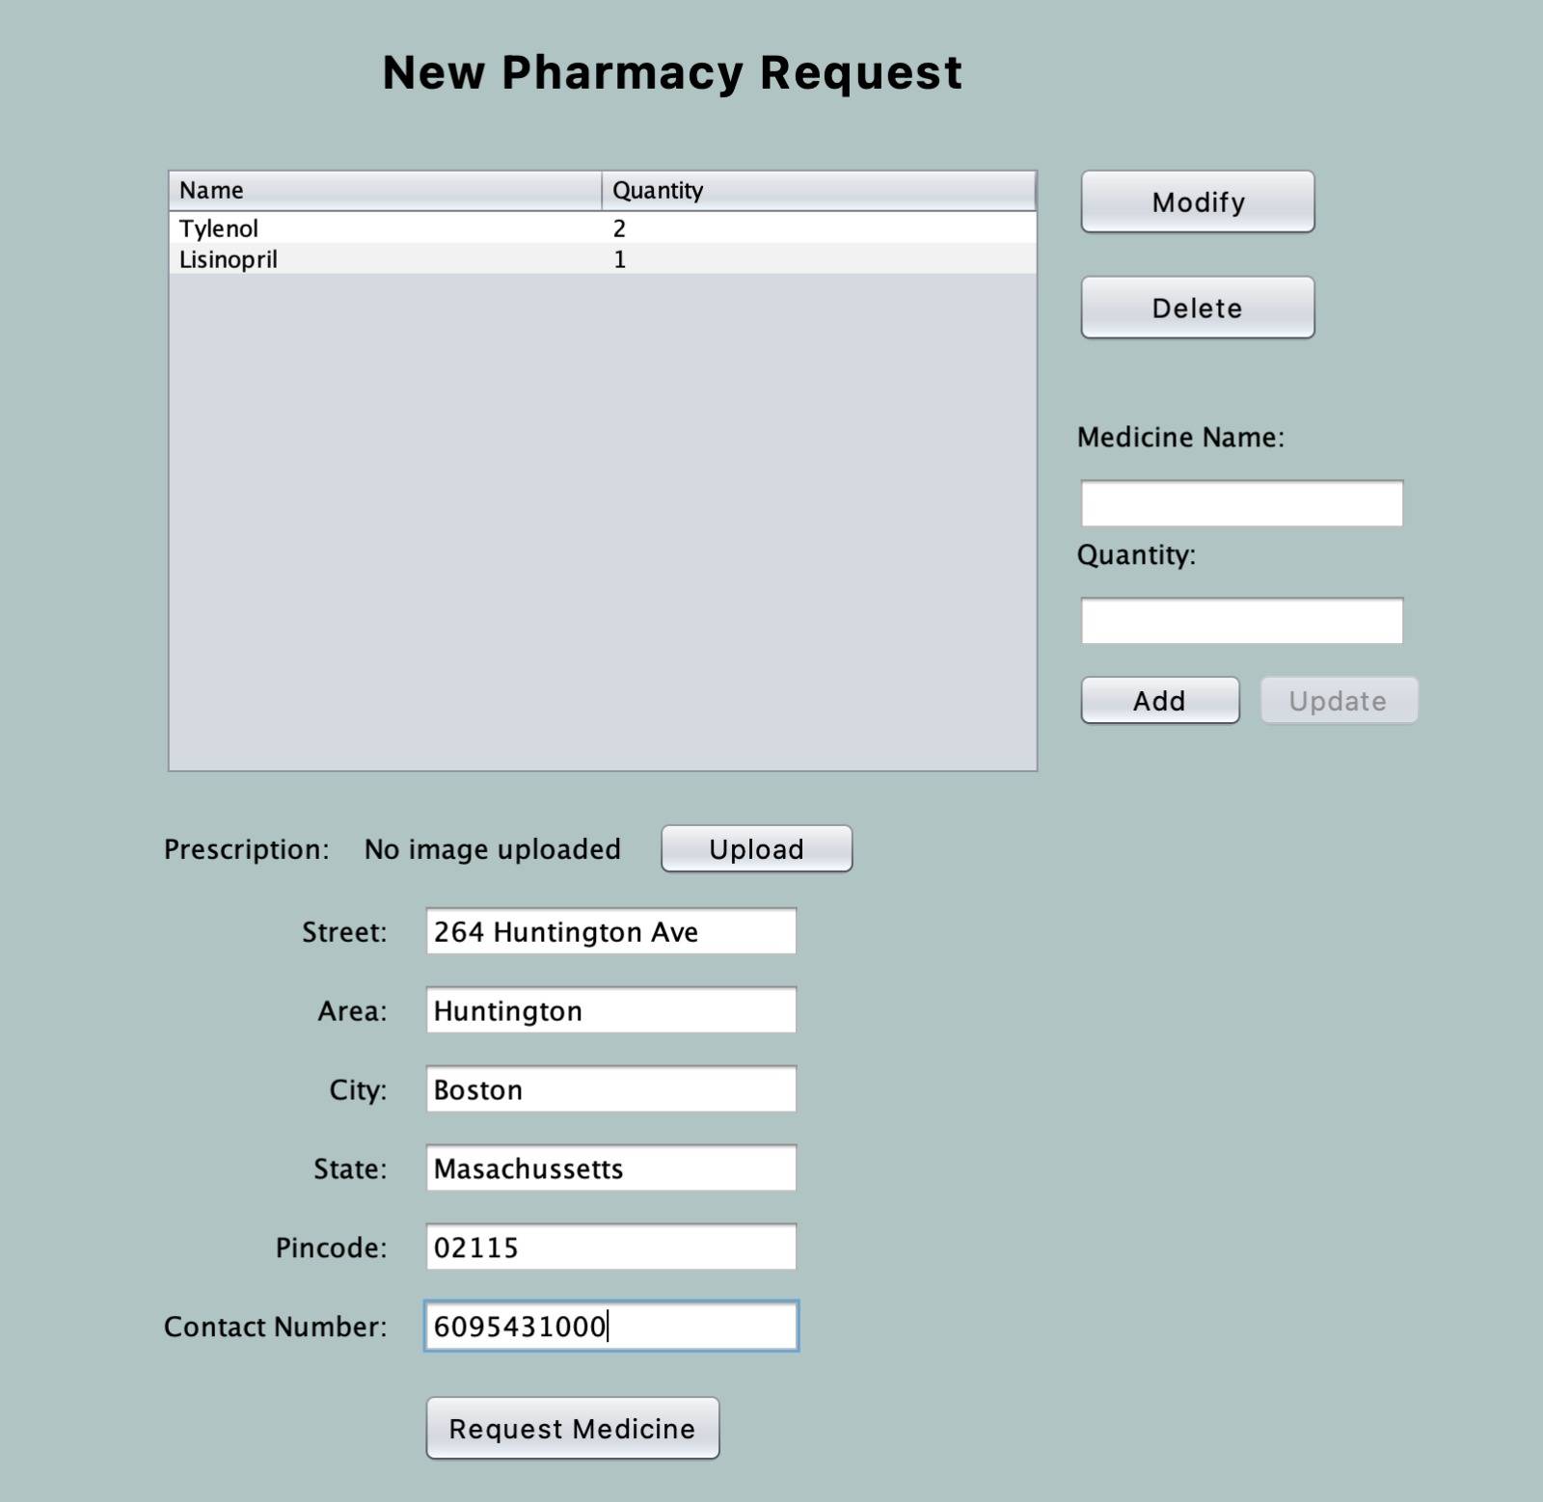

Slide 30
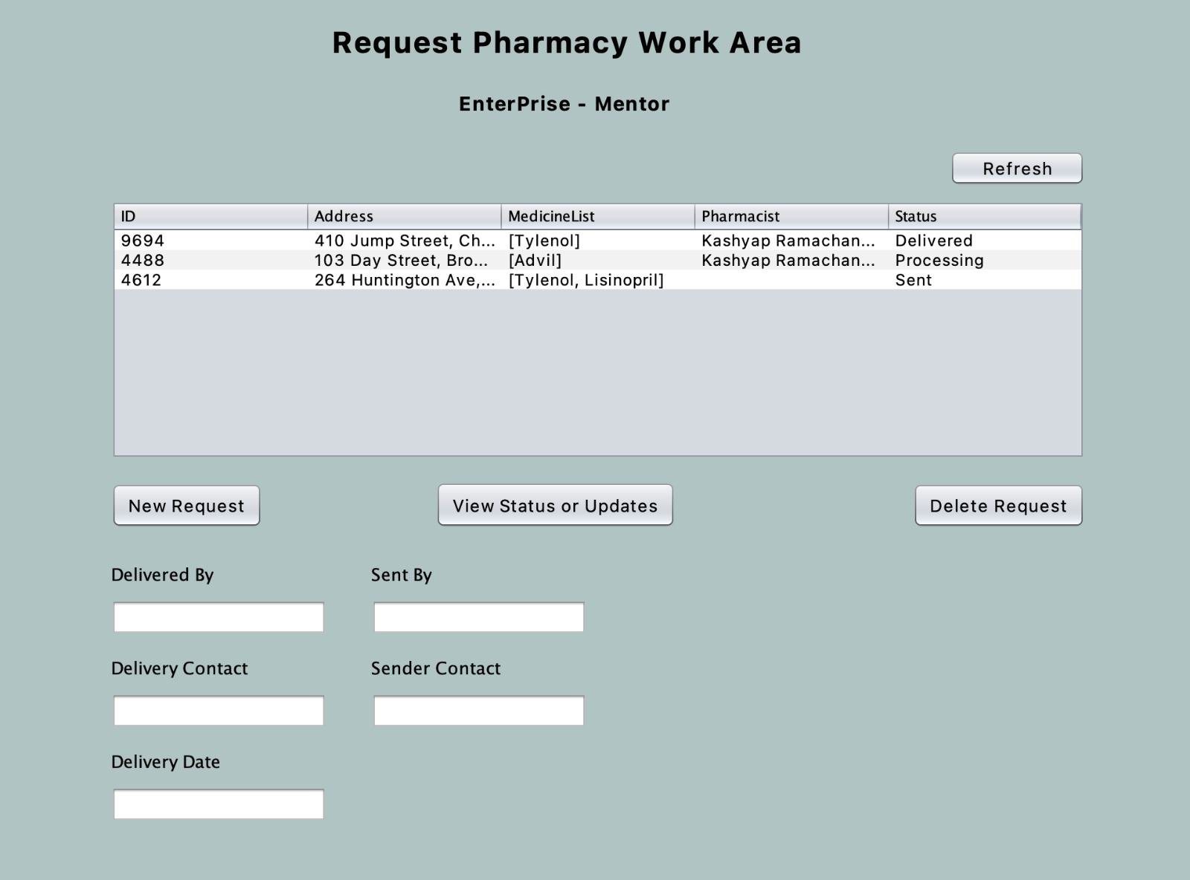

Slide 31
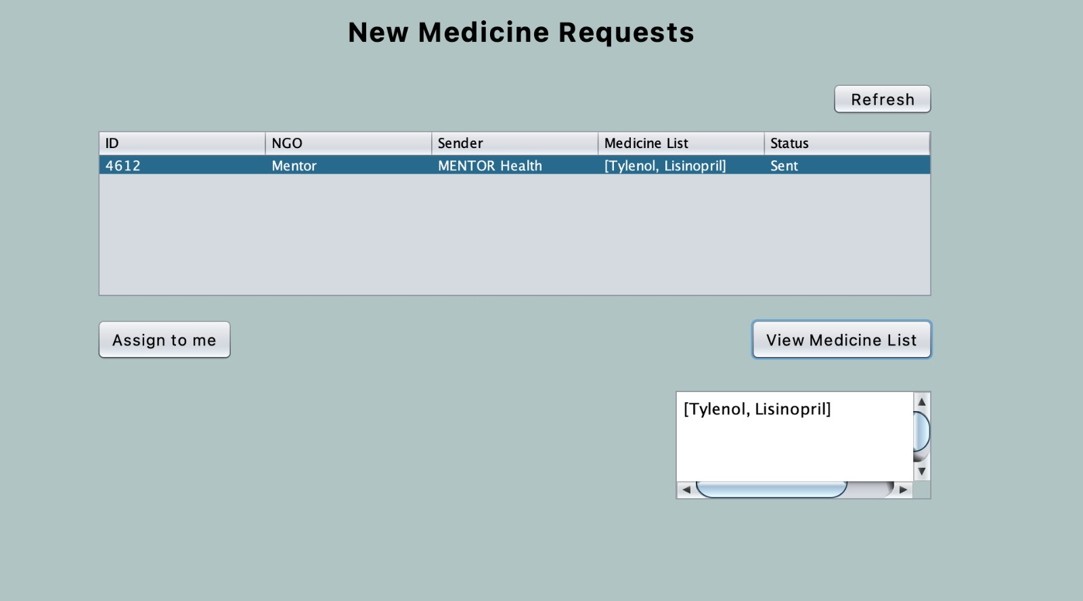

Slide 32
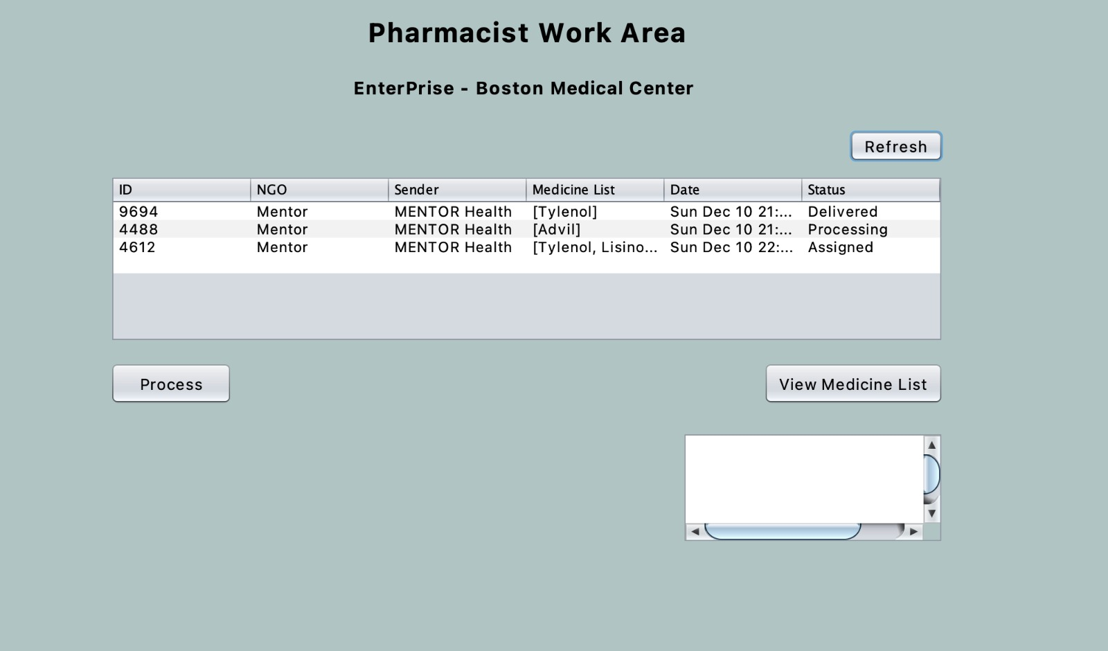

Slide 33
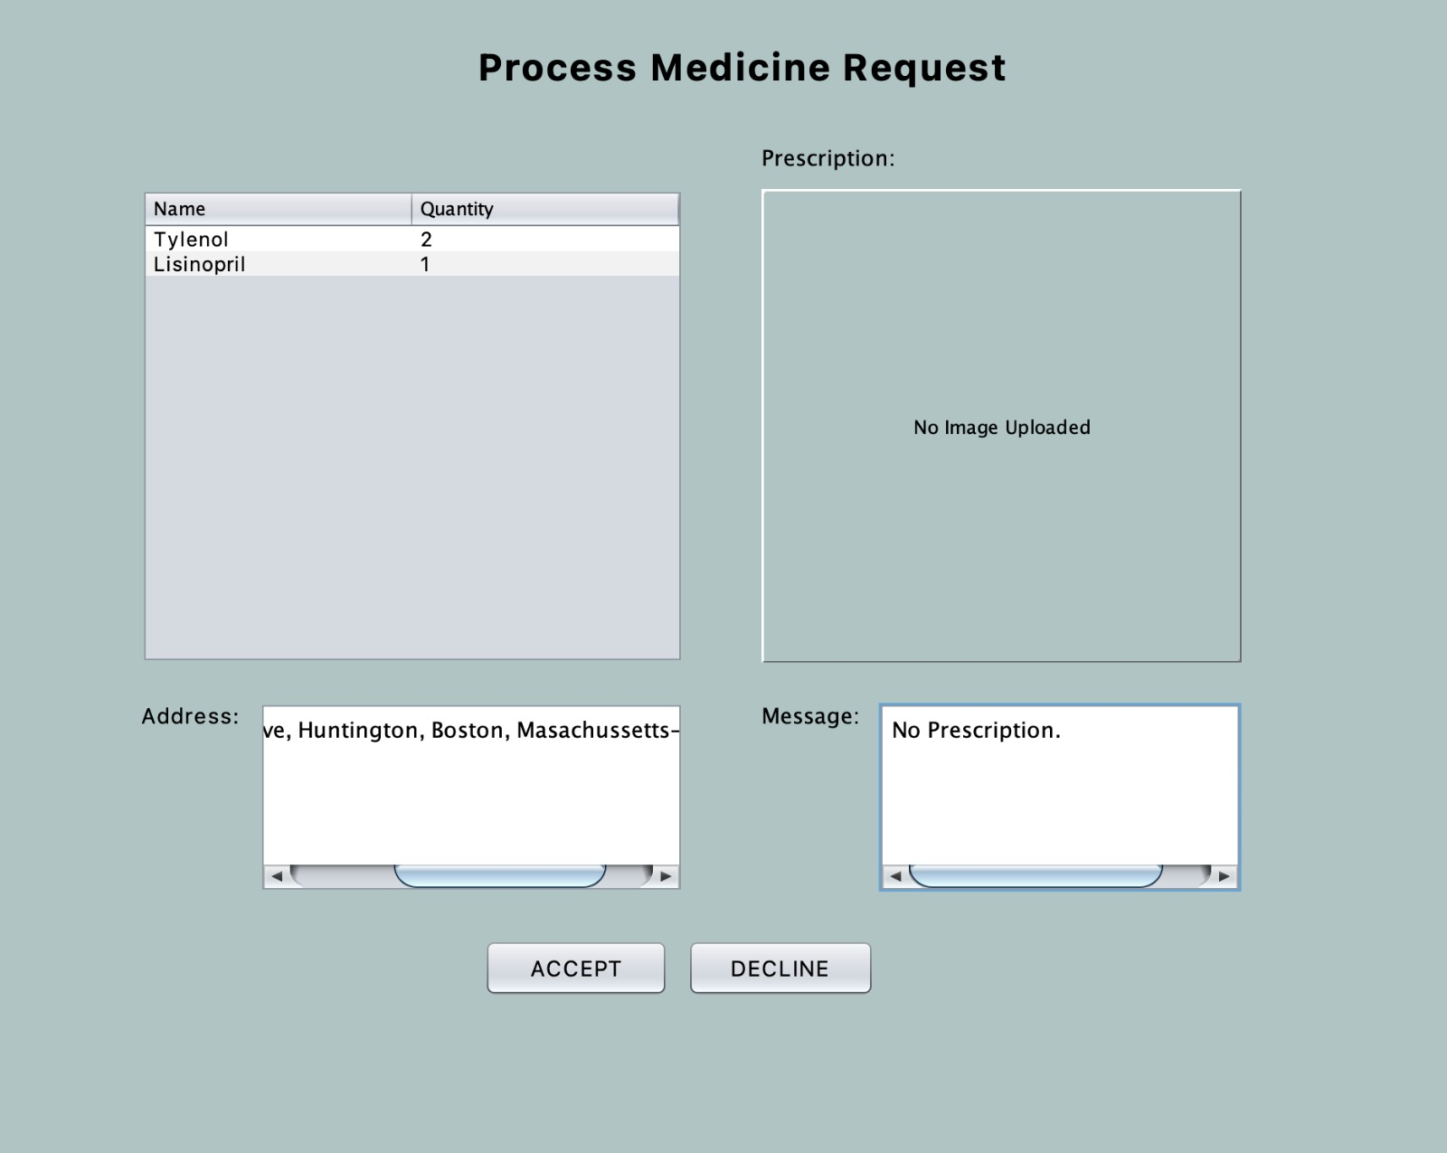

Slide 34
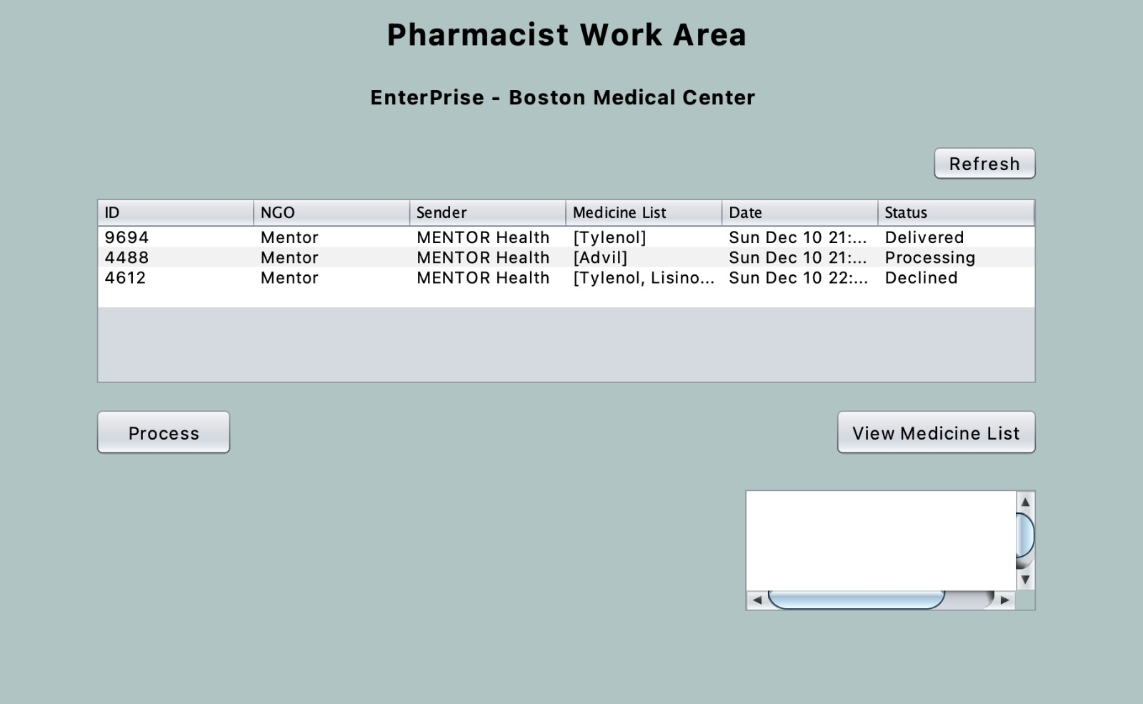

Slide 35
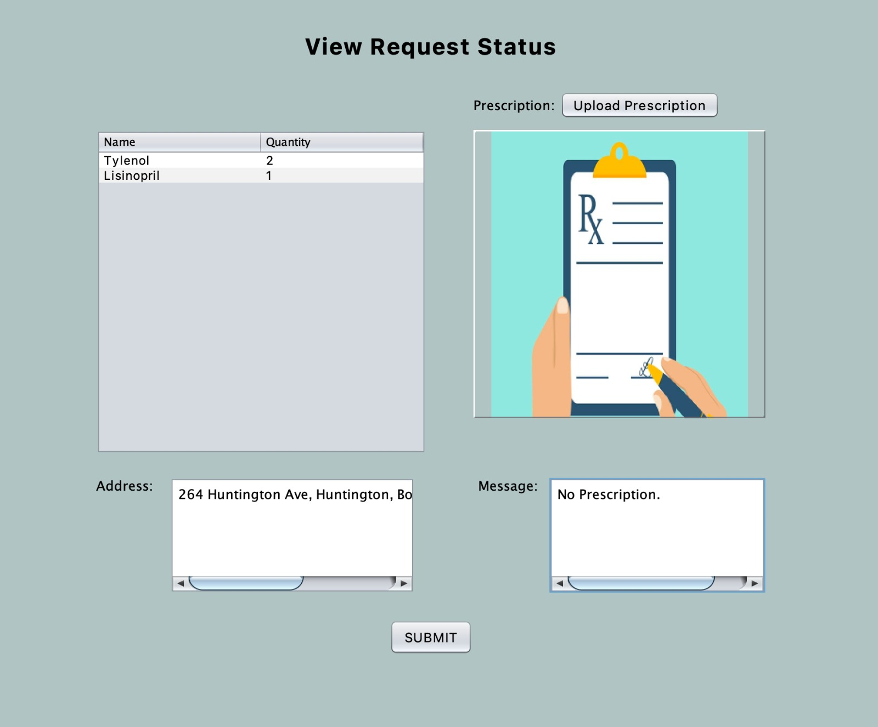

Slide 36
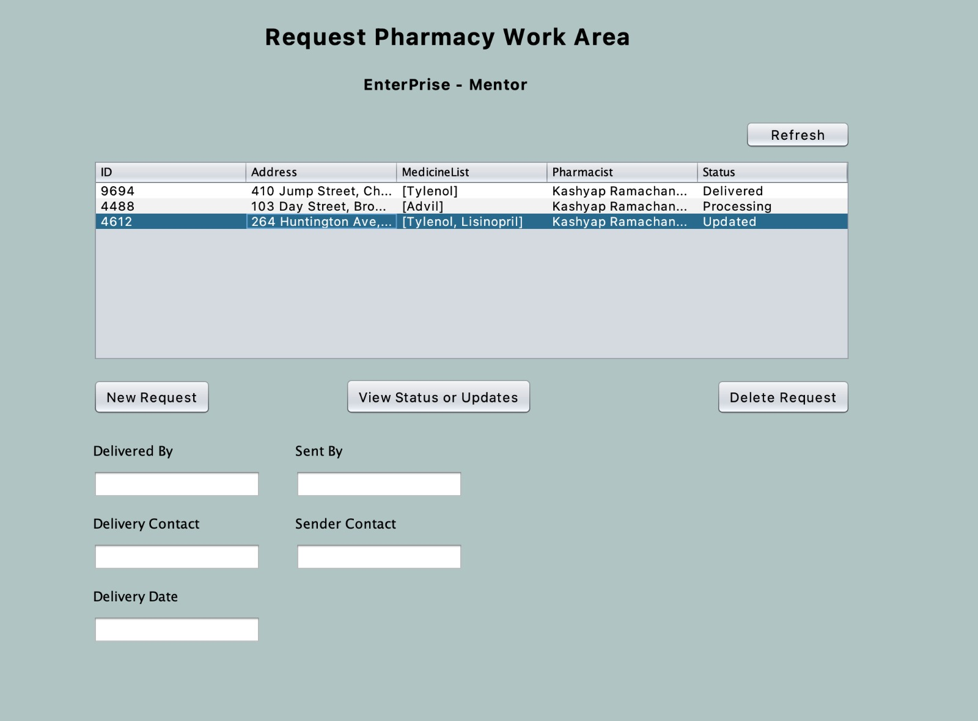

Slide 37
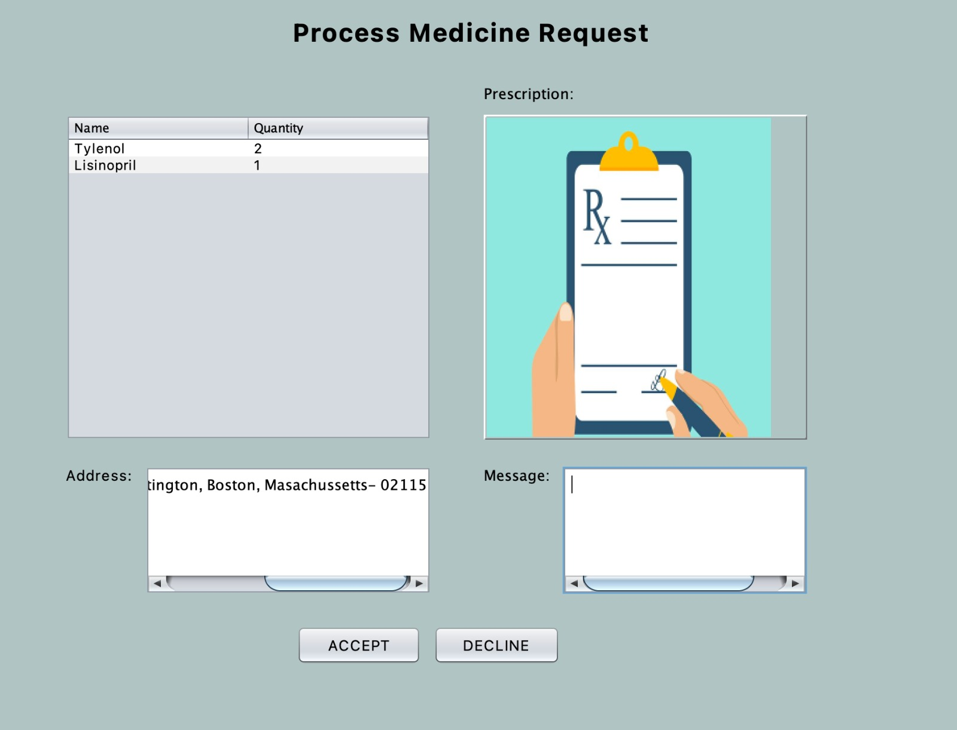

Slide 38
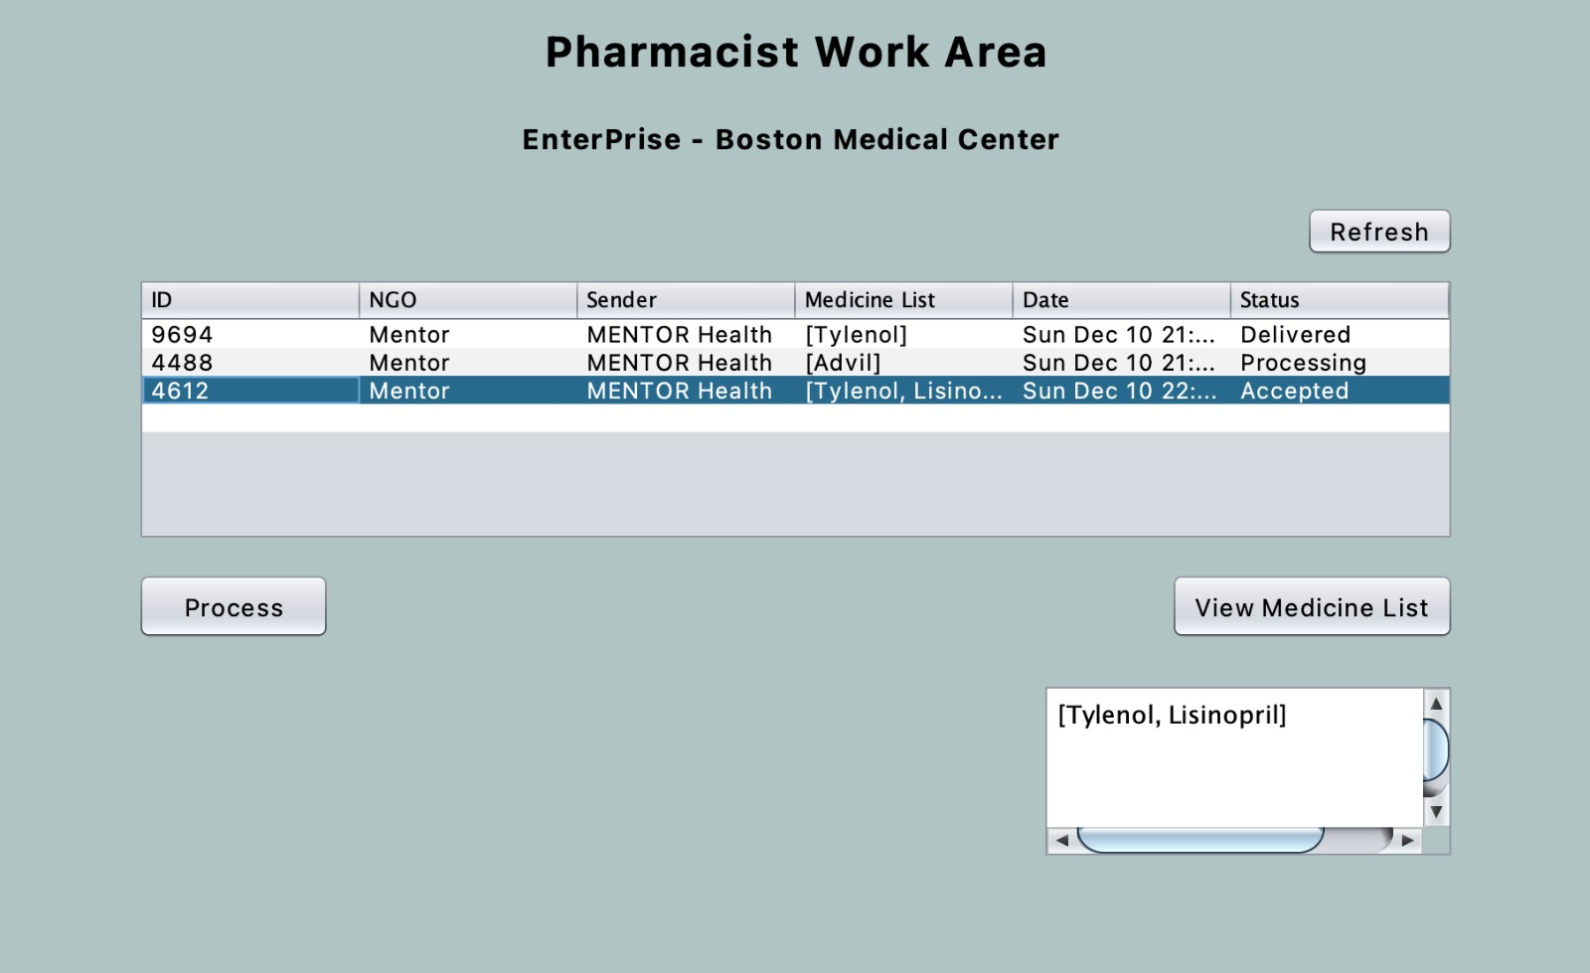

Slide 39
Use Case 5
INVENTORY AND PHARMACY – LOGISTICS WORKREQUEST

Slide 40
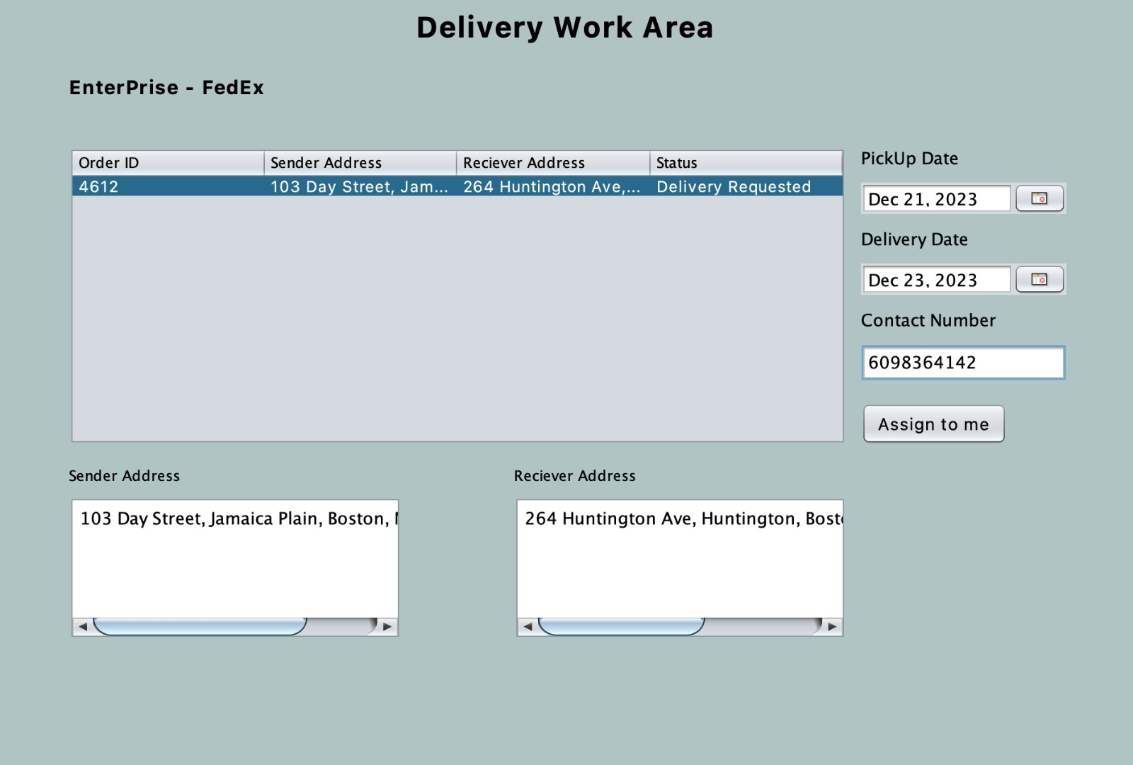

Slide 41
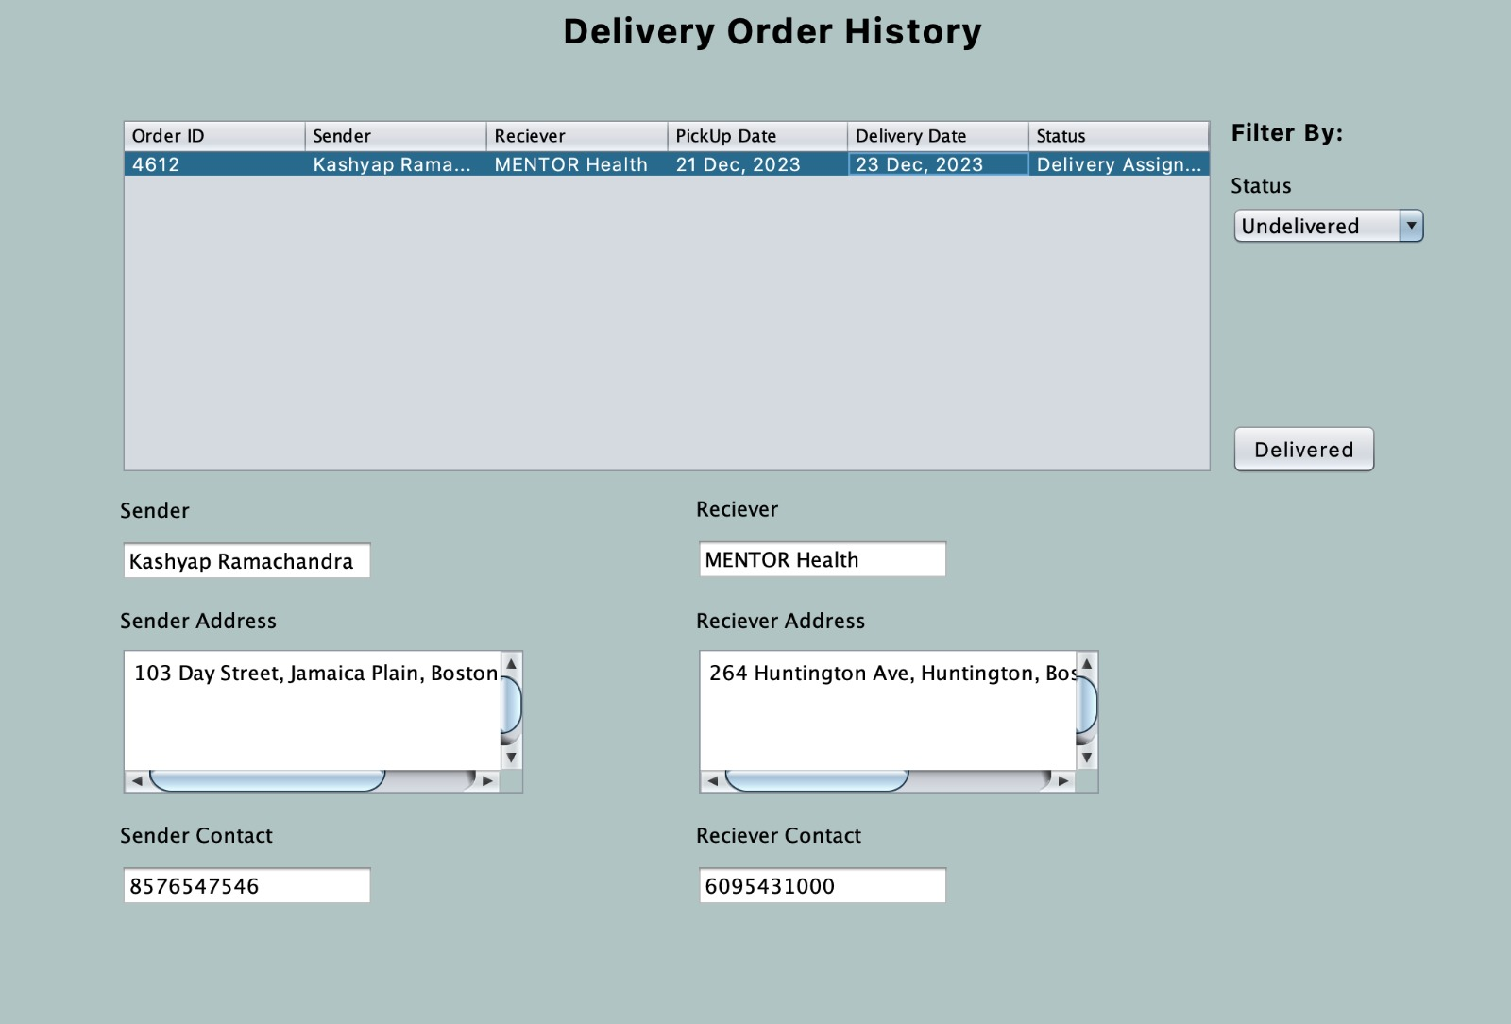

Slide 42
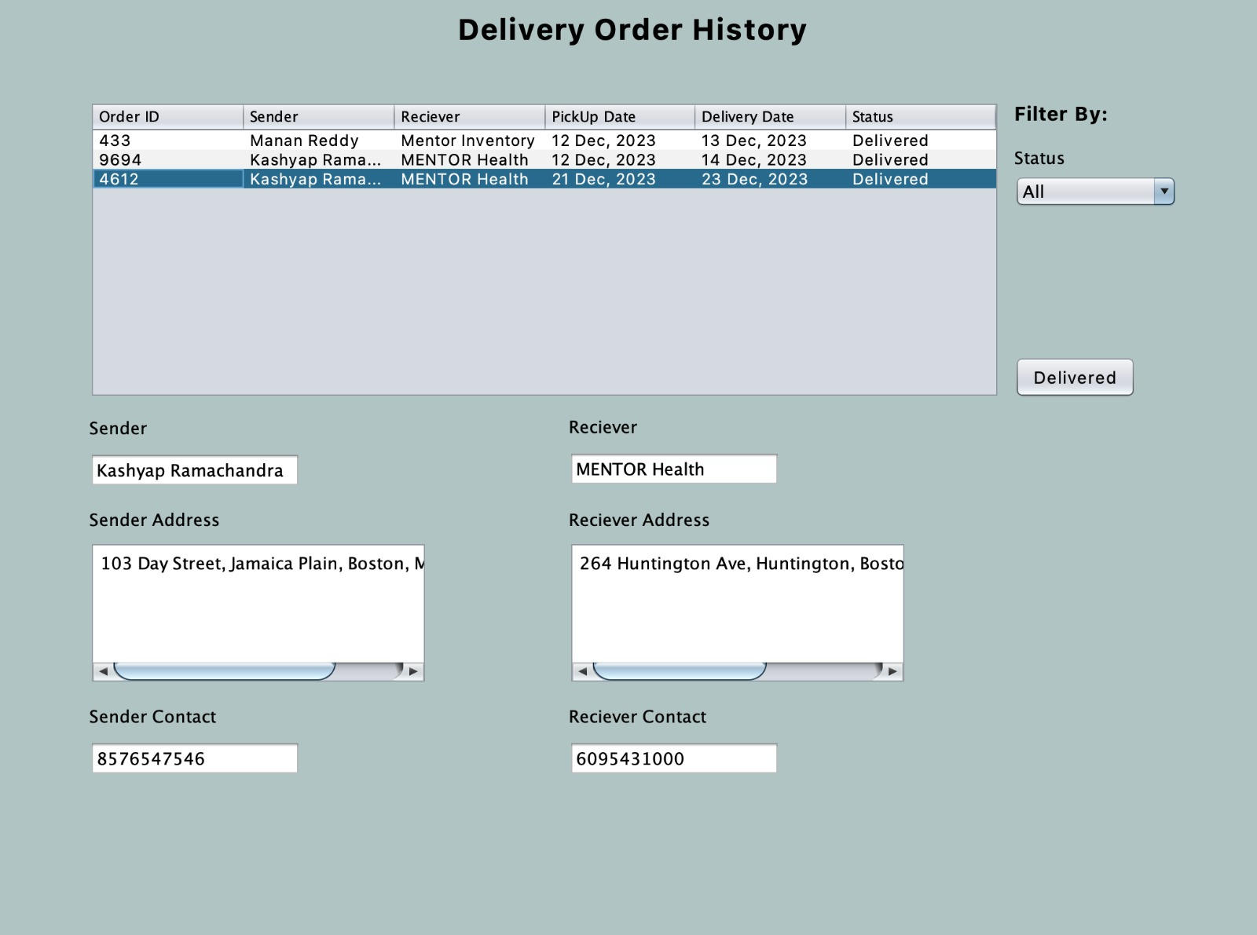

Slide 43
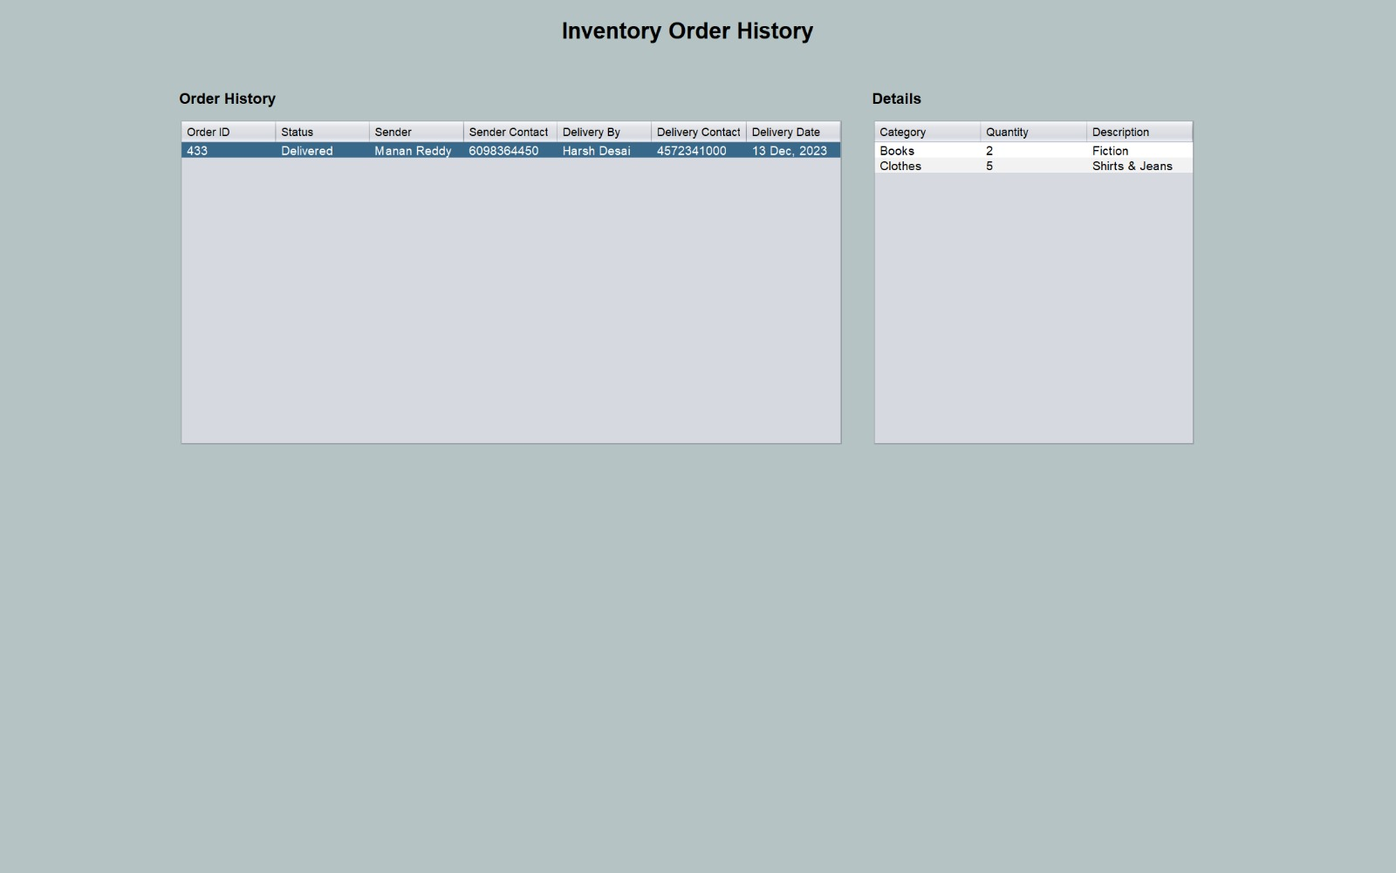

Slide 44
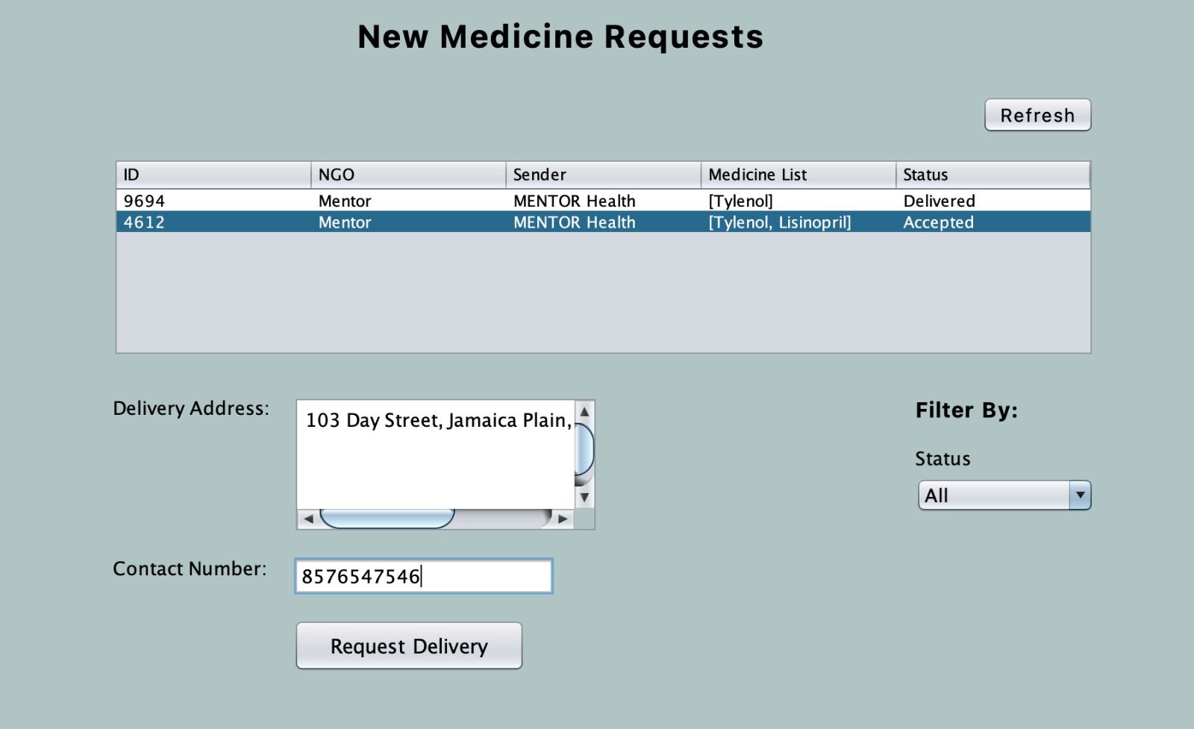

Slide 45
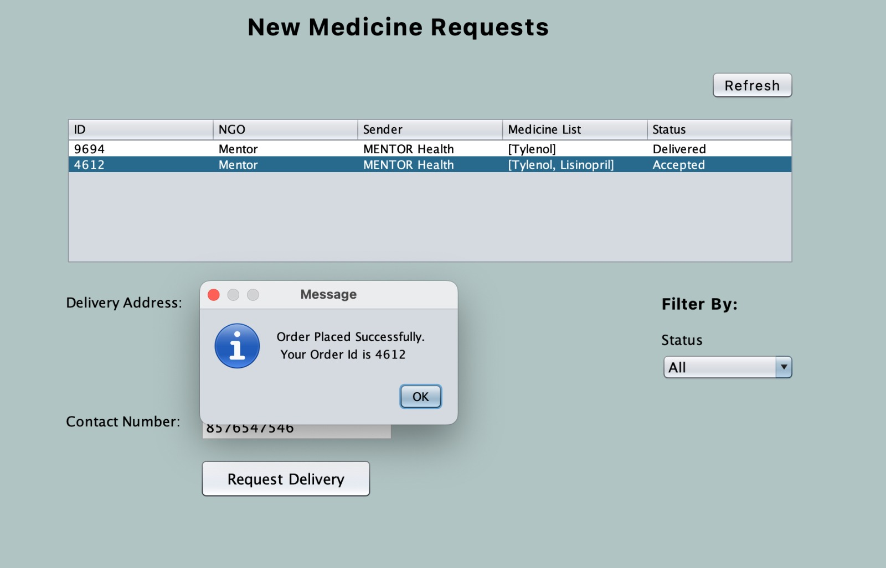

Slide 49
Use Case 6
GOVERNMENT ANALYSIS WORK REQUEST

Slide 50
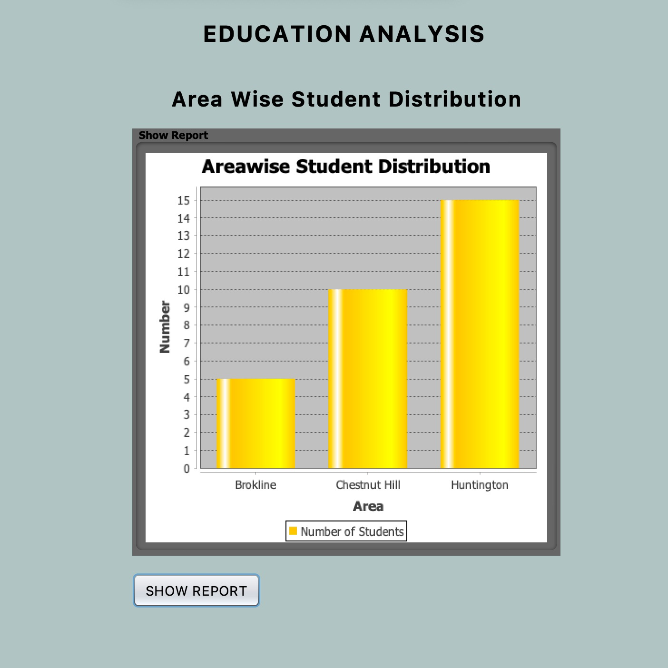

Slide 51
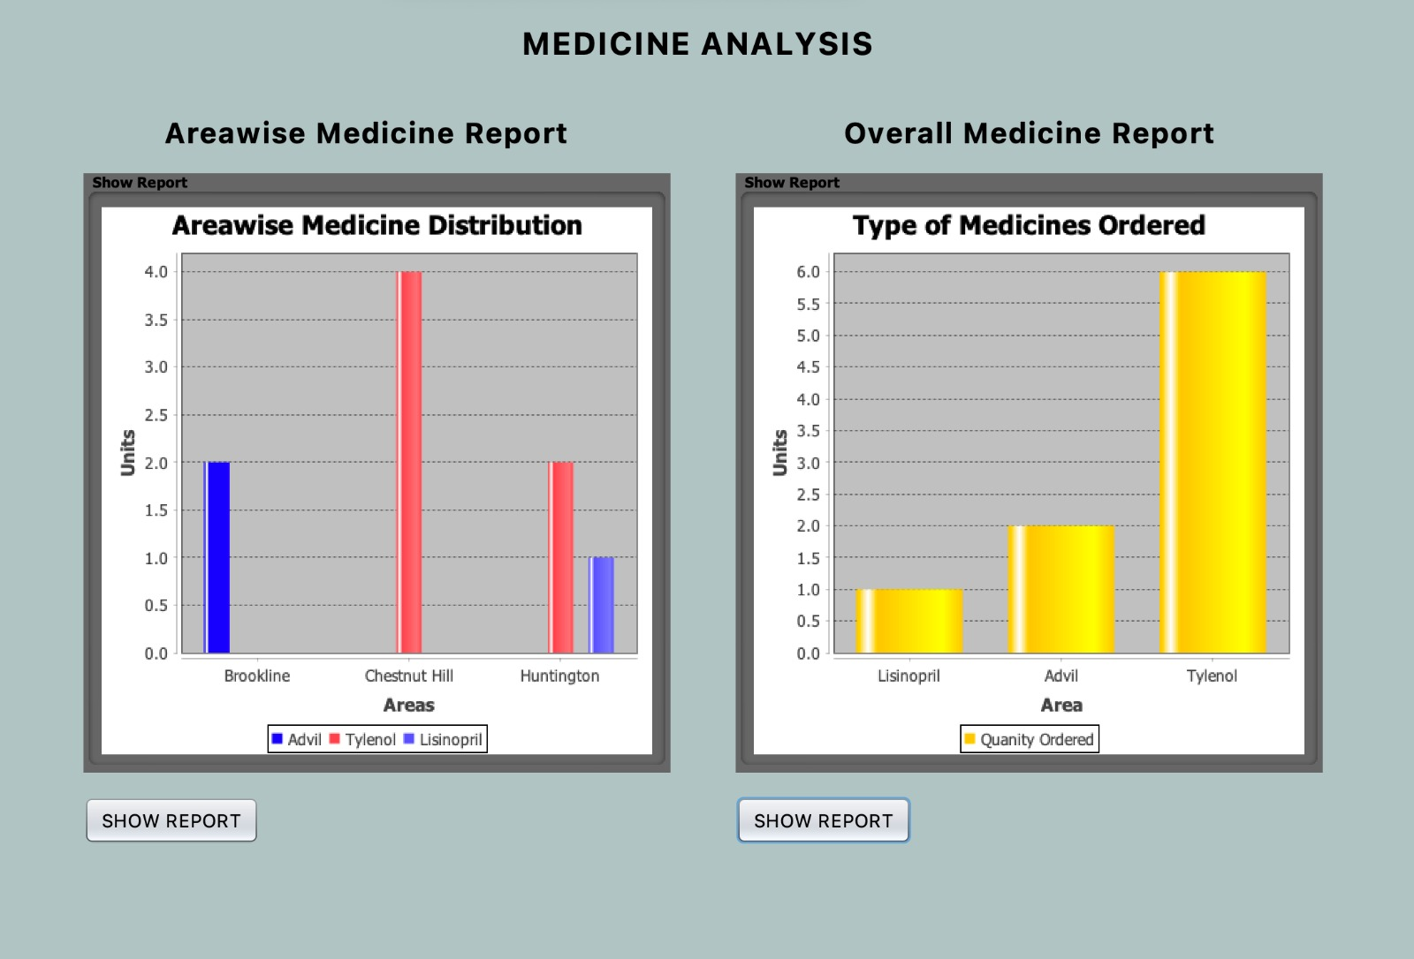

Slide 52
